Slide 1
Pressure
Unit 2

Slide 2
Force & Pressure
Force: In physics, a force is any influence that causes an object to undergo a change in speed, a change in direction, or a change in shape. A force has both magnitude and direction, making it a vector quantity.
Pressure is the force per unit area applied in a direction perpendicular to the surface of an object.

Slide 3
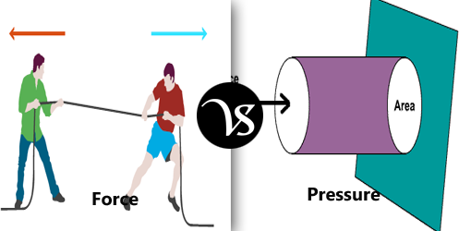
Force and Pressure

Slide 4
Unit is PSI or N/M²
1 atm=14.7 psi=1.013 bar=1.0197 kg/cm2\
Atmospheric pressure: weight of air in the earth’s atmosphere cause a pressure on objects within the atmosphere.
Absolute Pressure: any pressure measured from reference or datum or zero pressure is called an absolute pressure.

Slide 5
Vaccum: Pressure less than atmospheric pressure is usually referred to as either ‘negative gauge’ or ‘Vaccum’.

Slide 6
Torque
In physics, torque is the tendency of a force to turn or twist. If a force is used to begin to spin an object, or to stop an object from spinning, a torque is made.
The SI unit for torque is the newton metre (N⋅m)

Slide 7
Classification of Pressure Sensors and Transducers
Basically there are three types of pressure meaurements based on the range.
  Vaccum Measurements
  Atmospheric Pressure Measurements
  High Pressure Measurements
  Differential Pressure Meaurements

Slide 8
Based on Principle
Manometers type
  U tube manometers
  Well type manometers
Mechanical type
  Bourdon type
  Bellows
  Diaphragm

Slide 9
Electrical type
  Capacitive
  Inductive
  Piezo electric
  Resistive

Slide 10
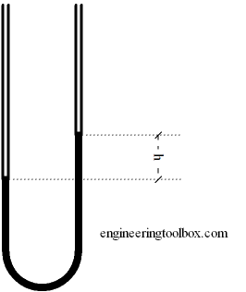
U-Tube Manometer

Slide 11
The pressure difference in a vertical U-Tube manometer can be expressed as
Pressure range -> 0 to 2 Kg/cm²
p_{d} = ρ g h
where
p_{d} = pressure
ρ = density (kg/m³, lb/ft³)
g = acceleration of gravity (9.81 m/s², 32.174 ft/s²)
h = liquid height (m, ft)

Slide 12
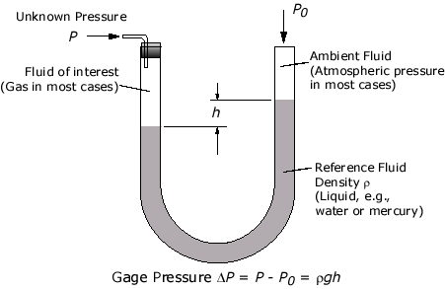

Slide 13
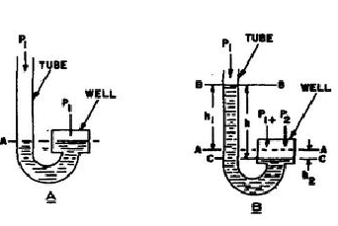
Well type

Slide 14
Manometer fluids
0.827 gm/cm² density -red oil
13.54 gm/cm² density -mercury

Slide 15
Advantages of U-tube Manometer:
Simple in construction
Low cost
Very accurate and sensitive
It can be used to measure other process variables.

Slide 16
Disadvantages of U-tube Manometer:
Fragile in construction.
Very sensitive to temperature changes.
Error can happen while measuring the h.

Slide 17
Characteristics of liquid used in U-tube Manometer:
Viscosity should be low.
Low surface tension is required.
The liquid should not stick on the walls.
Should not get vaporized.

Slide 18
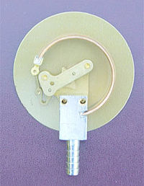
C Type Bourdon Tube
http://www.matec.org/animations/matec/M101FL01.swf

Slide 19
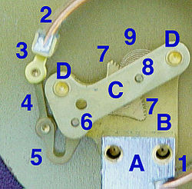
BT Construction

Slide 20
Stationary end of Bourdon tube. This communicates with the inlet pipe through the receiver block
Moving end of Bourdon tube and sealed.
Pivot and pivot pin
Link joining pivot pin to lever (5) with pins to allow joint rotation
Lever. This an extension of the sector gear (7)
Sector gear axle pin
Sector gear
Indicator needle axle

Slide 21
C-BT..
It is used to measure medium to very high pressures
Phosphor bronze -low pressure and SS or Monel – high pressure applications
Bourdon tube are simple in construction
They can be modified to give electrical outputs
Accuracy is high especially at high pressures
Susceptibility to shock and vibration
Usually require geared movement for amplification

Slide 22
they respond slowly to changes in pressure
they are subjected to hysterisis.
They are sensitive to shocks and vibrations.
Amplification is a must as the displacement of the free end of the bourdon tube is low.
It cannot be used for precision measurement.

Slide 23
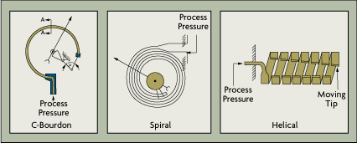
Types in BT

Slide 24
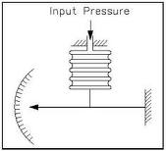
Bellows

Slide 25
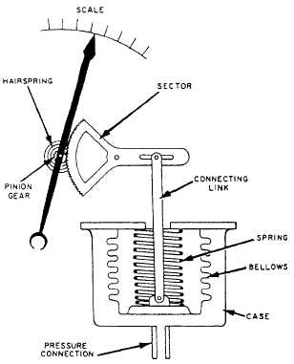

Slide 26
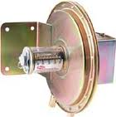
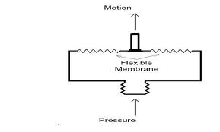
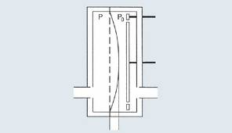
Diaphragm

Slide 27
Like BT elements, the elastic elements in bellows gauges are made of brass, phosphor bronze, stainless steel, beryllium-copper, and non metals
Most of bellows gauges are spring loaded to increase life and pressure range

Slide 28
Types
Flat
corrugated
capsule

Slide 29
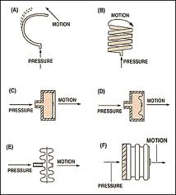

Slide 30

Capacitive Pressure transducer
Where C is the capacitance
ε₀ is the permittivity of free space constant
K is the dielectric constant of the material in the gap
A is the area of the plates, and d is the distance between the plates.

Slide 31
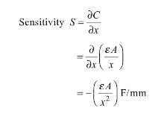
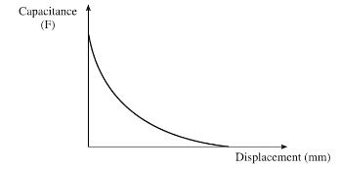
Response of Capacitive Transducer

Slide 32
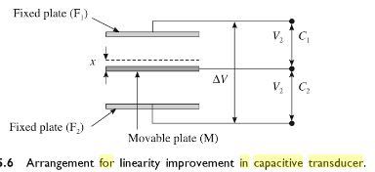

Slide 33
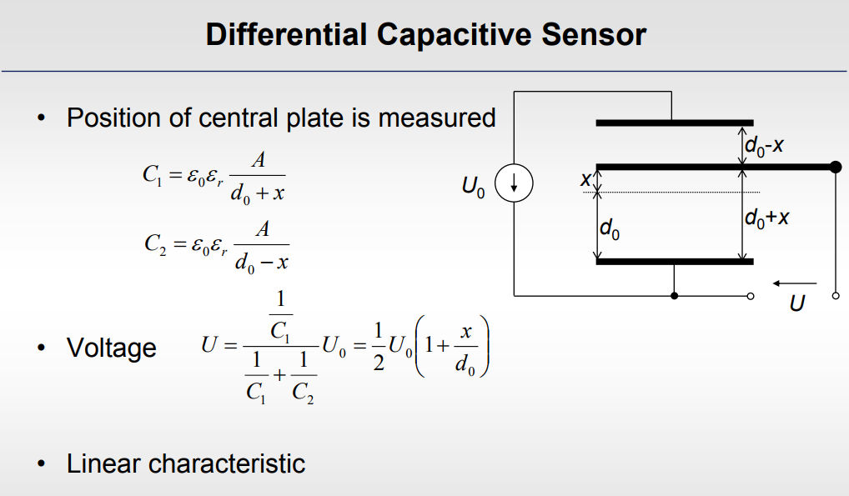

Slide 34
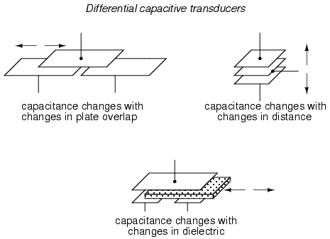

Slide 35

Pressure application

Slide 36
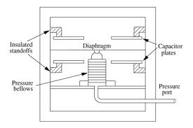

Slide 37
Piezoelectric Transducers
Certain crystals like crystalline produce an emf when deformed by an application of pressure along the specific axis
Active Transducer and Inverse Transducer
Natural crystals
  Quartz
Synthetic polycrystalline
  Barium titanate

Slide 38
Piez…
The natural crystals are already polarized
Synthetic polycrystalline ceramic materials have to be made under a strong dc electric field to provide polarization
The piezoelectric effect is direction sensitive
The magnitude of the generated surface charge q is proportional to the applied force ‘F’. Q=dF where d is charge senstivity in C/N

Slide 39
Piezo..
pressure, acceleration, strain
Active transducers
Dynamic measurement
It has very high DC output impedance
The output signal is then related to this mechanical force

Slide 40
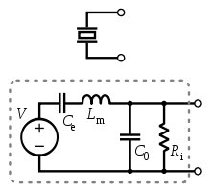
Piezo Symbol and eqn ckt

Slide 41
Piezo derivation
The output voltage E₀ = Q/C_{p}
Where Q is charge = d.F where d charge sensitivity and F is applied force
C_{p} is capacitance between electrodes = (ξ A)/t;
E₀= d.F.t/ ξ A= gtP since P=(F/A) and g is Voltage sensitivity
Natural are Quartz and Rochelle
Synthetic are lithum sulphate, ethylene diamine titrate

Slide 42
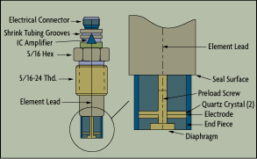
Typical Piezoelectric Pressure Sensor

Slide 43
Acceleration-Compensated
Piezoelectric Sensor

Slide 44


Strain Gauge
The strain gage is one of the most widely used in strain measurement sensors.
It is a resistive elastic unit whose change in resistance is a function of applied strain.

Slide 45
Types of strain gauges: i) Unbonded metal strain gauges ii) Bonded metal wire strain gauges iii) Bonded metal foil strain gauges iv) thin metal film strain gauges v) semiconductor and vi) diffused metal
Strain gauges are made of Nickel, manganim nichrome, platinum

Slide 46
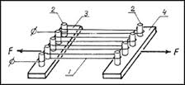
Unbonded type

Slide 47
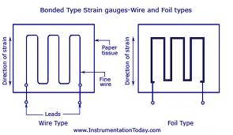

Slide 48
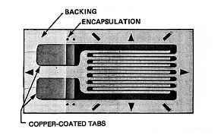

Slide 49
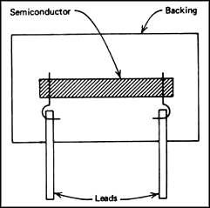

Slide 50
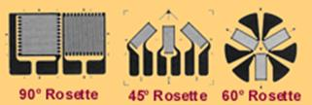
Strain Gauge Rosette

Slide 51
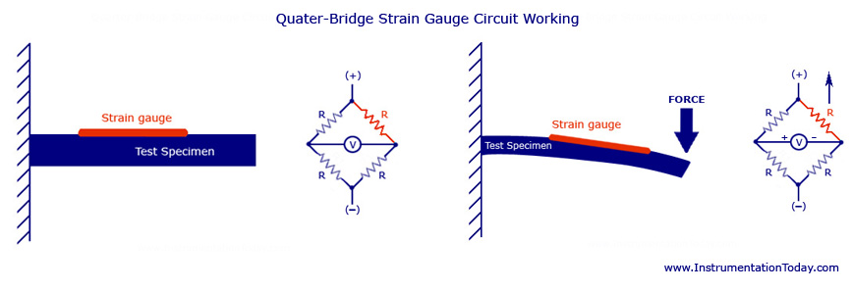
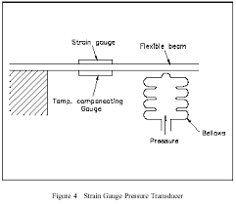
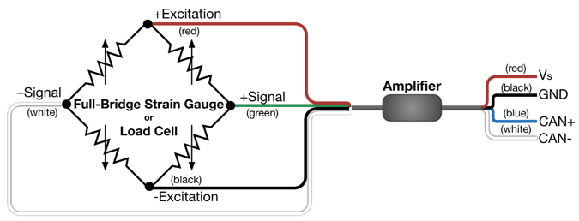
Pressure or Force Measurement using strain gauge and mechanical sensor

Slide 52
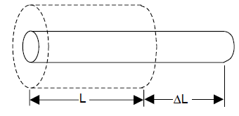












Gauge Factor of Strain Gauge

Slide 53
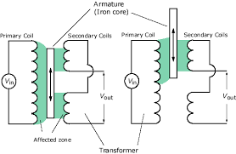
LVDT
Linear variable differential transformer
Variation in inductance with displacement
Consisting of one primary and two identical secondary windings
At primary winding, sinusoidal voltage (3 to 15 V) and frequency is in kHz (upto 20000)

Slide 54
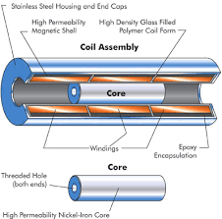
LVDT..

Slide 55
LVDT..
Mutual Inductance
Movable core of high permeability
When the core is in the middle and same voltage at two secondary coils
So, ideal output voltage is zero because of differential connection of secondary coils
There is small residual output signal at the null position

Slide 56
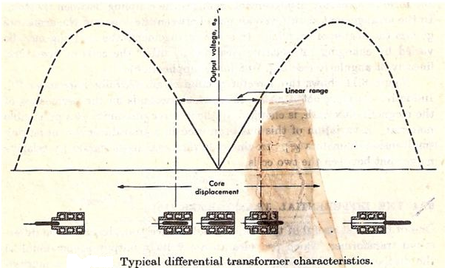
LVDT characteristics

Slide 57
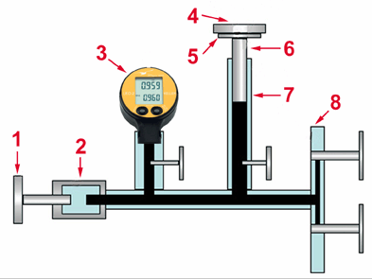
Dead weight pressure gauge

Slide 58
1 – Hand pump
2 - Testing Pump
3 - Pressure Gauge to be calibrated
4 - Calibration Weight
5 - Weight Support
6 - Piston
7 - Cylinder
8 - Filling Connection

Slide 59
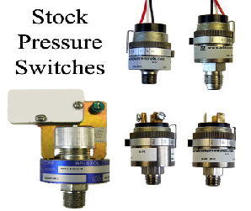
Pressure Switches

Slide 60
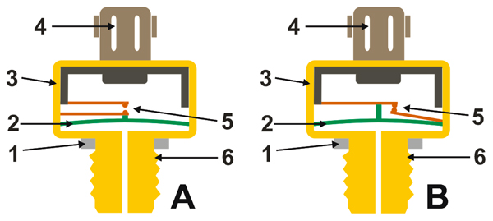
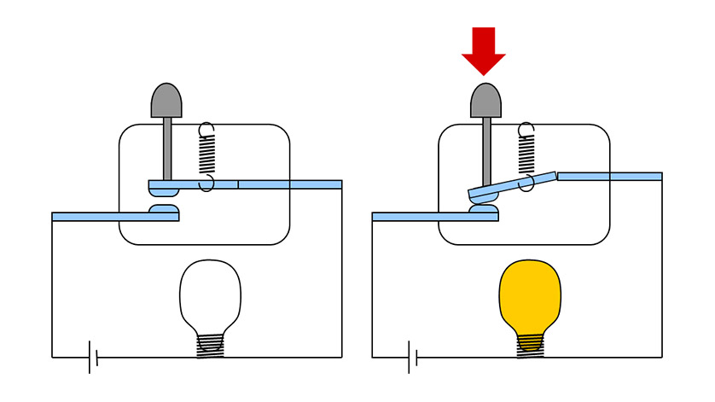

Slide 61
Vaccum measurement
McLeod gauge (manometer based)
Thermal conduction
a) Thermocouple b) RTD or Pirani
Ionization Types
Units 1 atmosphere=760 torr=1.013x10⁵ Pa

Slide 62
McLeod gauge
A known volume gas is compressed to a smaller volume whose final value provides an indication of the applied pressure
P1V1=P2V2
Where, P1 = Pressure of gas at initial condition (applied pressure).
P2 = Pressure of gas at final condition.
V1 = Volume of gas at initial Condition.
V2 = Volume of gas at final Condition.
Initial Condition == Before Compression.
Final Condition == After Compression.

Slide 63
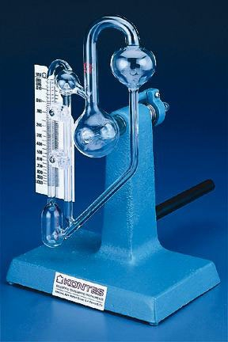
Mcle..

Slide 64
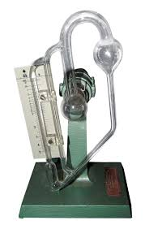
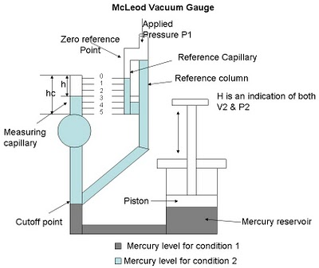

Slide 65
McLe…
The pressure to be measured (P1) is applied to the top of the reference column of the McLeod Gauge as shown in diagram
The applied pressure fills the bulb and the capillary
When the mercury level reaches the cutoff point, a known volume of gas is V1
The mercury level is further raised by operating the piston to Zero reference Point

Slide 66
Mcle..
In this condition, the volume of the gas is V2 and pressure P2
We have, P1V1 = P2V2
Therefore, P1V1= (P1+hρ)ah
P1V1 = P1ah + a ρ h^2
P1V1-P1ah = a ρ h^2
P1 = a ρ h^2/(V1-ah) = (a ρ h^2)/V1
Thus the applied pressure is calculated using the McLeod Gauge

Slide 67
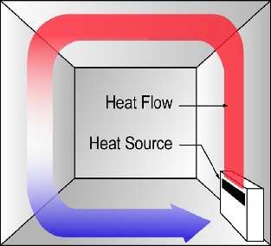
Heat flow due to convection

Slide 68
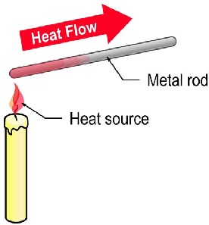
Heat flow due to conduction

Slide 69
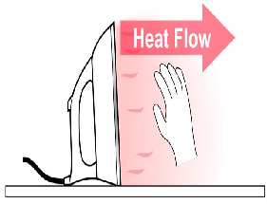
Heat flow due to radiation

Slide 70
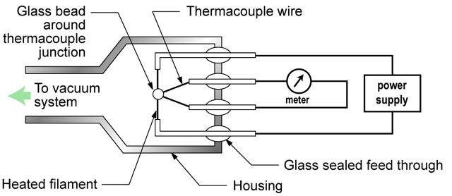
Thermocouple Gauge

Slide 71
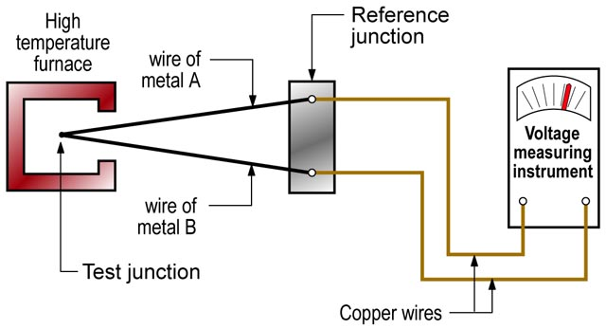

Slide 72
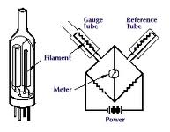
Pirani Gauge

Slide 73
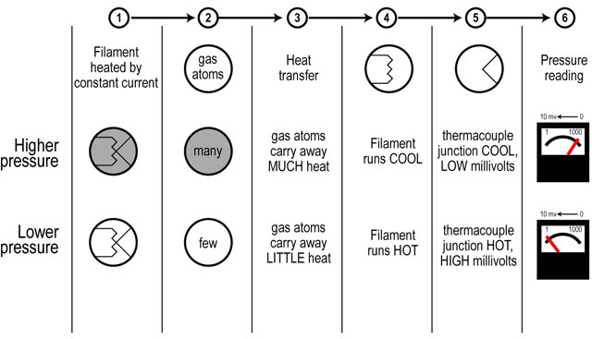

Slide 74
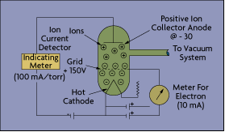
Hot Cathode

Slide 75
It measures vacuum by making use of the current carried by ions formed in the gas by the impact of electrons
Most hot-cathode sensors measure vacuum in the range of 10⁻² to 10⁻¹⁰ torr.

Slide 76
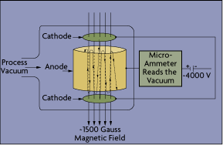
Cold cathode

Slide 77
Cold..
The major difference between hot and cold cathode sensors is in their methods of electron production
In a cold cathode device, electrons are drawn from the electrode surface by a high potential field
Typical measuring range is from 10⁻¹⁰ to 10⁻² torr

Slide 78
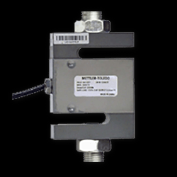


Load Cell

Slide 79
Load Cell…
A load cell is a transducer that is used to convert a force into electrical signal
Through a mechanical arrangement, the force being sensed deforms a strain gauge
A load cell usually consists of four strain gauges in a Wheatstone bridge configuration
The output of the transducer is plugged into an algorithm to calculate the force applied to the transducer

Slide 80
Torque Measurement
Torque is a measure of how much force acting on an object causes that object to rotate
Torque is measured by either sensing the actual shaft deflection caused by a twisting force, or by detecting the effects of this deflection
A strain gage can be installed directly on a shaft
The strain gage also can be connected via a transformer, eliminating the need for high maintenance slip rings

Slide 81


Torque Meas…

Slide 82


Slide 83


Slide 84
Shaft’s power measurement
A dynamometer or "dyno" for short, is a machine used to measure torque and power produced by an engine, motor or other rotating prime mover can be calculated
A dynamometer that is designed to be driven is called an absorption or passive Dynamometer
A dynamometer that can either drive or absorb is called a universal or active dynamometer

Slide 85

Dynamometer

Slide 86

Only torque and speed can be measured; Power must be calculated from the torque and speed figures according to the formula:

Slide 87

To calculate power in horsepower (hp) use:

Slide 88

To calculate power in kilowatts use:

Slide 89
Sound Measurement
It is an oscillation of pressure wave and it can pass through solid, liquid, or gas.
Frequencies are within the range of hearing
The measuring unit is decibel dB
Most simple noise measurements are made using the "A" frequency weighting and the results expressed in dB(A).

Slide 90


Slide 91

Sound meter

Slide 92

Octave filter spectrum

Slide 93
Microphone
It is an acoustic-to-electric transducer or sensor that converts sound into an electrical signal.
Most microphones today use electromagnetic induction (dynamic microphone), capacitance change (condenser microphone), piezoelectric generation, or light modulation to produce an electrical voltage signal from mechanical vibration.

Slide 94

Condenser microphone
The condenser microphone is also called a capacitor microphone or electrostatic microphone—capacitors were historically called condensers.
Here, the diaphragm acts as one plate of a capacitor, and the vibrations produce changes in the distance between the plates.

Slide 95

Electret microphone
The externally applied charge described above under condenser microphones is replaced by a permanent charge in an electret material.
An electret is a ferroelectric material that has been permanently electrically charged or polarized.

Slide 96


Slide 97

Moving-coil microphones
Moving-coil microphones use the same dynamic principle as in a loudspeaker, only reversed.
A small movable induction coil, positioned in the magnetic field of a permanent magnet, is attached to the diaphragm.

Slide 98

Crystal microphone or piezo microphone
A crystal microphone or piezo microphone uses the phenomenon of piezoelectricity- the ability of some materials to produce a voltage when subjected to pressure -to convert vibrations into an electrical signal.

Slide 99

Fiber optic microphone
A fiber optic microphone converts acoustic waves into electrical signals by sensing changes in light intensity, instead of sensing changes in capacitance or magnetic fields as with conventional microphones.

